Slide 1
The Love Israel Family (the Church of Jesus Christ at Armageddon)
Raising Children as 'Physically Immortal' in a Polygamous Commune

Slide 2
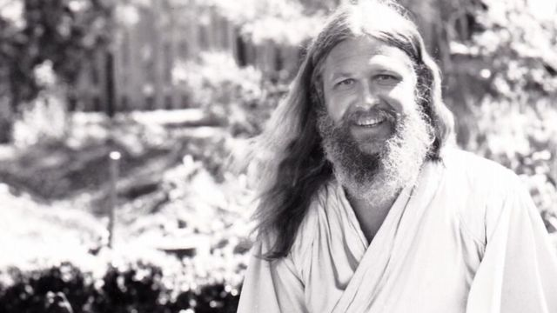
Timeline
Paul Erdmann (1940-2016) – aka Love Israel
Born in Berlin from a German-American baroness and French-German father (briefly arrested by Nazi troops)
Attended finishing schools, college, became a successful car salesman
Moved to San Francisco and became part of hippie movement
1968 religious house in Queen Anne Hill, Seattle
1970s Acquired Arlington Ranch, Washington (~316 members)
1983-4 Breakup
2003 remaining 100 members sell Arlington Ranch, Washington

Slide 3
We are one. Love is the answer. Now is the time.
The true Israelites: celebrate Passover, robes, full beards, Hebrew names, polygynous marriage…
Monistic concept of God
”God is not in Heaven but here and now”
True Resurrection - the mind and body of Christ
Seeing Jesus in others’ eyes
Revelations through visions and dreams – drug use
Bible as verification of that which is revealed in visions
Immortality, time as an illusion

Slide 4
Hierarchy
Patriarchal
Love → Council of Elders → “youngers”
Hebrew vs. Virtue names
Sexual freedom as marker of status
1st year of abstinence and sanctioning

Slide 5
Children
Discipline: seclusion & “spare the rod spoil the child”
Education
Health
Communal living: - biological relationships vs. oneness
Sexual abuse and drug consumption: the age problem
Effects of the breakup

Slide 6
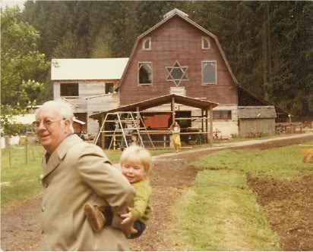

Slide 8
Sources
LeWarne, Charles P. The Love Israel Family: Urban Commune, Rural Commune. Washington Press (2009).
Balch, Robert W. “Money and Power in Utopia: An Economic History of the Love Family” in Money and Power in the New Religions ed. James T. Richardson, The Edwin Mellen Press (1988), Studies in Religion and Society Vol. 22, (pp. 185-221).
Israel, Rachel. Counterculture Crossover: Growing Up in the Love Family. Life Story Press (2018).
Phone interview with Rachel Israel
Phone interview with Robert Balch

